Slide 1
REGRESSION ANALYSIS
Stamatics project
Group 3 - Presentation
Harish Mehta 200404
Keval Solanki 200991

Slide 2
Non – Linear Regression
Nonlinear regression is a form of regression analysis in which data is fit to a model and then expressed as a mathematical function.
nonlinear regression relates the two variables in a nonlinear (curved) relationship.
Nonlinear regression models are widely used in many applications such as in dose-response studies conducted in agricultural sciences, toxicology, and other biological sciences.
Nonlinear regression models are important tools in the agricultural field because many crops and soil properties are better represented by nonlinear than linear models.
Non-linear data is usually encountered in daily life.
For Example Projectile Motion, Equation of motion under free fall

Slide 3
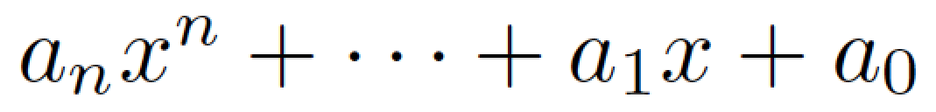
Polynomial Regression
Equation:
Y =
Polynomial regression is a form of regression analysis in which the relationship between the independent variable x and the dependent variable y is modelled as an nth degree polynomial in x...

Slide 4
Model : Year-wise Crop production
This regression model is about the data of yearly crop production.
ML model is trained on the data of crop production from the year 1950-51 to 2016-17. It was tested for the years after that, for which it predicted quite well.
Due to the importance of agricultural production in human life, accurate prediction of the production of crops could be really helpful.
Production depends on many factors such as rainfall, natural disasters, land availability, technology development, etc.. But neglecting the factors which are not in our hands, crop production can be predicted pretty accurately with the dataset of year-wise crop production.

Slide 5
Approach
Source of data:
  https://data.world/indoagri/indian-year-wise-crop-production/workspace/file?filename=year_wise_indian_crop_production.csv
  https://agricoop.nic.in/sites/default/files/pocketbook_0.pdf
Language used: Python
Tools used: sci-kit learn, numpy, pandas

Slide 6
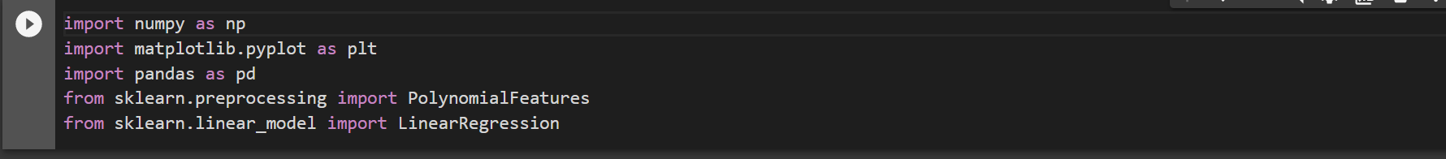
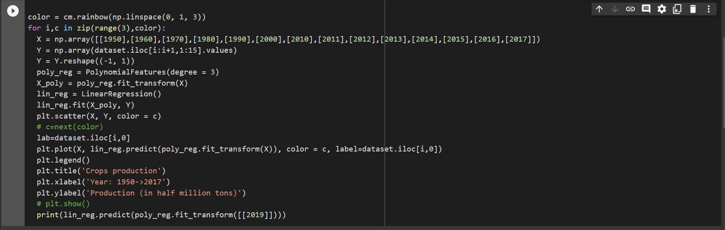
Code

Slide 7
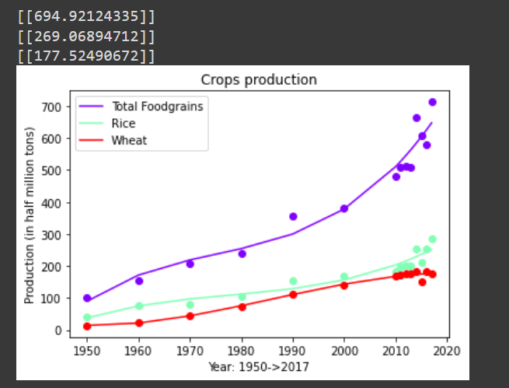
Plot

Slide 8
Thank you

